Slide 1
Software Verification Validation and Testing
Software Verification Validation and Testing

Slide 2
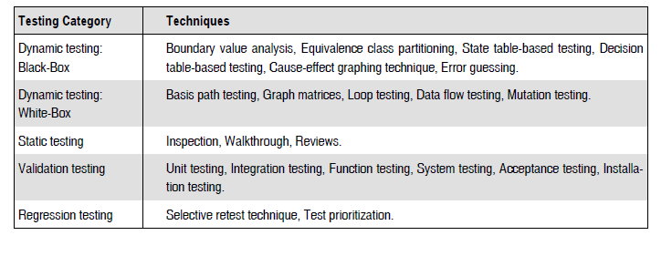
Testing techniques

Slide 3
EQUIVALENCE CLASS TESTING(ECP)
Input values to a program is partitioned into a set of equivalence classes.
The main idea behind defining the equivalence classes is that testing the code with any one value belonging to an equivalence class is as good as testing the software with any other value belonging to that equivalence class.
Equivalence classes for a software can be designed by examining the input data and output data.
To use equivalence partitioning, one needs to perform two steps:
1. Identify equivalence classes
2. Design test cases

Slide 4
Guidelines for designing the Equivalence classes
If the input data values to a system can be specified by a range of values, then one valid and two invalid equivalence classes should be defined.
If the input data assumes values from a set of discrete members of some domain, then one equivalence class for valid input values and another equivalence class for invalid input values should be defined.

Slide 5
Example1
For a software that computes the square root of an input integer which can assume values in the range of 0 to 5000. The three equivalence classes will be:
- A set of negative integer
- A set of integer between 0-5000
- An integer greater than 5000
Therefore, the test cases must include representatives for each of the three equivalence classes.
A possible test set can be: {-5,500,6000}.

Slide 6
Example 2
A program reads three numbers, A, B, and C, with a range [1, 50] and prints the largest number. Design test cases for this program using equivalence class testing technique.

Slide 7
Solution
1. First we partition the domain of input as valid input values and invalid values, getting the following classes:
I1 = {<A,B,C> : 1 ≤ A ≤ 50}
I2 = {<A,B,C> : 1 ≤ B ≤ 50}
I3 = {<A,B,C> : 1 ≤ C ≤ 50}
I4 = {<A,B,C> : A < 1}
I5 = {<A,B,C> : A > 50}
I6 = {<A,B,C> : B < 1}
I7 = {<A,B,C> : B > 50}
I8 = {<A,B,C> : C < 1}
I9 = {<A,B,C> : C > 50}
Now the test cases can be designed from the above derived classes, taking one test case from each class such that the test case covers maximum valid input classes, and separate test cases for each invalid class.

Slide 8
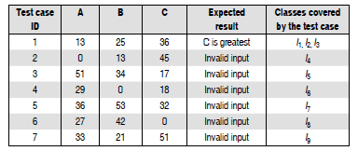
The test cases are shown below:

Slide 9
Example3
A program determines the next date in the calendar. Its input is entered in the form of <ddmmyyyy> with the following range:
1 ≤ mm ≤ 12
1 ≤ dd ≤ 31
1900 ≤ yyyy ≤ 2025
Its output would be the next date or an error message ‘invalid date.’ Design test cases using equivalence class partitioning method.

Slide 10
Solution
First we partition the domain of input in terms of valid input values and invalid values, getting the following classes:
I1 = {<m, d, y> : 1 ≤ m ≤ 12}
I2 = {<m, d, y> : 1 ≤ d ≤ 31}
I3 = {<m, d, y> : 1900 ≤ y ≤ 2025}
I4 = {<m, d, y> : m < 1}
I5 = {<m, d, y> : m > 12}
I6 = {<m, d, y> : d < 1}
I7 = {<m, d, y> : d > 31}
I8 = {<m, d, y> : y < 1900}
I9 = {<m, d, y> : y > 2025}
The test cases can be designed from the above derived classes, taking one test case from each class such that the test case covers maximum valid input classes, and separate test cases for each invalid class.

Slide 11
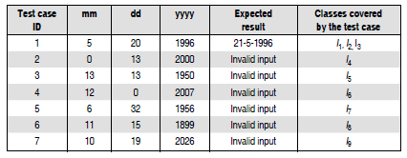
The test cases are shown below:

Slide 12
Thank you!

